Slide 1
Chat BOT IN JAVASCRIPT
ARTIFICIAL INTELLIGENCE
RA2232241040034
MOHAMED FIRNAS

Slide 2
abstract
This project introduces a JavaScript powered chatbot, designed to provide natural and engaging conversational interactions with users across various digital platforms. The chatbot leverages the power of JavaScript and its ecosystem to deliver real-time responses, making it adaptable for websites, mobile apps, and other digital environments. We delve into the architecture, design principles, and key features that enable this chatbot to understand and respond to user queries effectively. Additionally, we discuss the integration of natural language processing libraries and frameworks to enhance its conversational capabilities. The chatbot's extensibility, scalability, and integration potential with third-party APIs make it a valuable tool for businesses and developers seeking to implement interactive and user-friendly virtual agents. This paper serves as a foundation for understanding the core components and potential applications of a JavaScript-based chatbot in today's digital landscape.

Slide 3
MODULE Description
This JavaScript code handles the functionality of the chatbot and initializes the chatbot, handles user input, and simulates chatbot responses. In a real chatbot, you would replace the placeholder logic in generate Chatbot response with more advanced natural language processing and response generation. The function to creates chat messages as list items, and the generate response function interacts with the Open AI API to get responses. The chatbot processes user input, displays “Thinking…” and eventually provides responses from the AI. The chatbot's core functionality and processing are hosted on cloud servers, which enables scalability, flexibility, and ease of deployment.

Slide 4
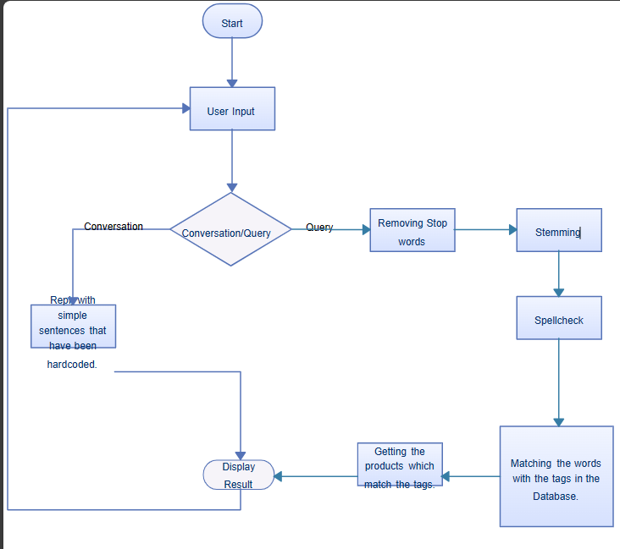
WORKFLOW

Slide 5
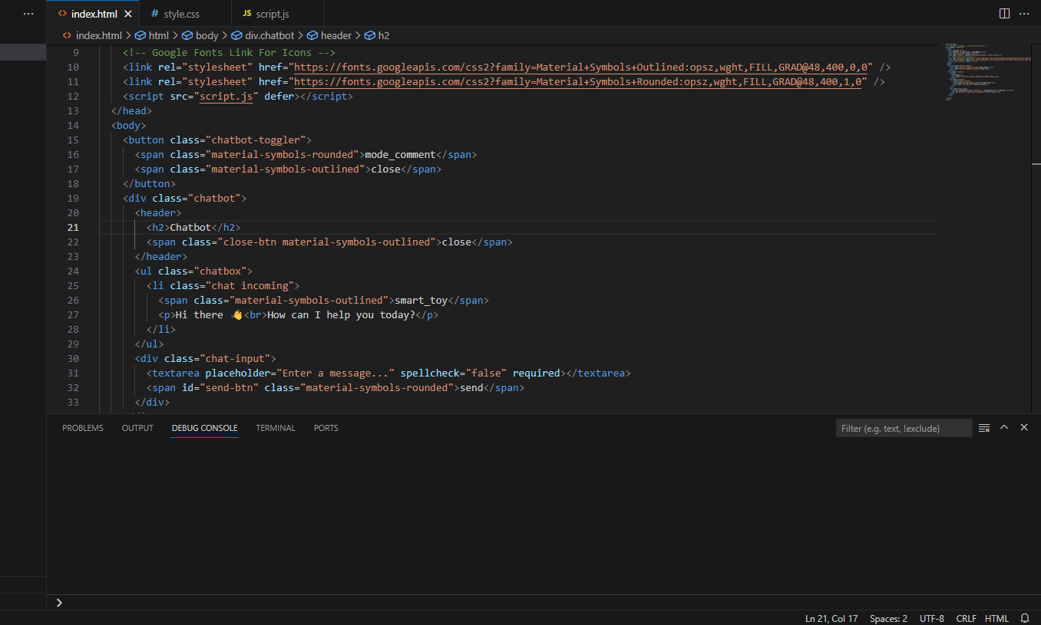
INPUT SCREENSHOT

Slide 6
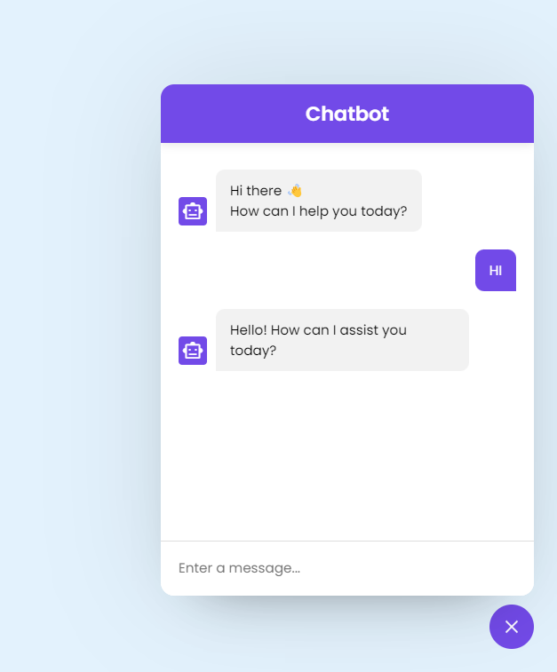
OUTPUT SCREENSHOT

Slide 7
conclusion
In conclusion, this project provides a functional chatbot interface that integrates with the OpenAI GPT-3.5 Turbo API. It demonstrates the potential for creating interactive and conversational AI applications on web platforms. Further development and fine-tuning can make this chatbot even more versatile and user-friendly.

